Slide 1
GESTURE CONTROLLED ROBOT
MAHATMA GANDHI INSTITUTE OF TECHNOLOGY, GANDIPET - 500075
PRESENTED BY:
B.ANUSHA(22261A0409),
HEEBA FIRDOUSE (22261A0424),
N.INDUPRIYA (22261A0441)

Slide 2
Introduction to Gesture Controlled Robots
Gesture controlled robots are innovative devices that respond to human gestures for navigation and operation. These robots utilize sensors and software to interpret hand movements and translate them into commands. The integration of Bluetooth technology allows for wireless control from a distance, enhancing usability.

Slide 3
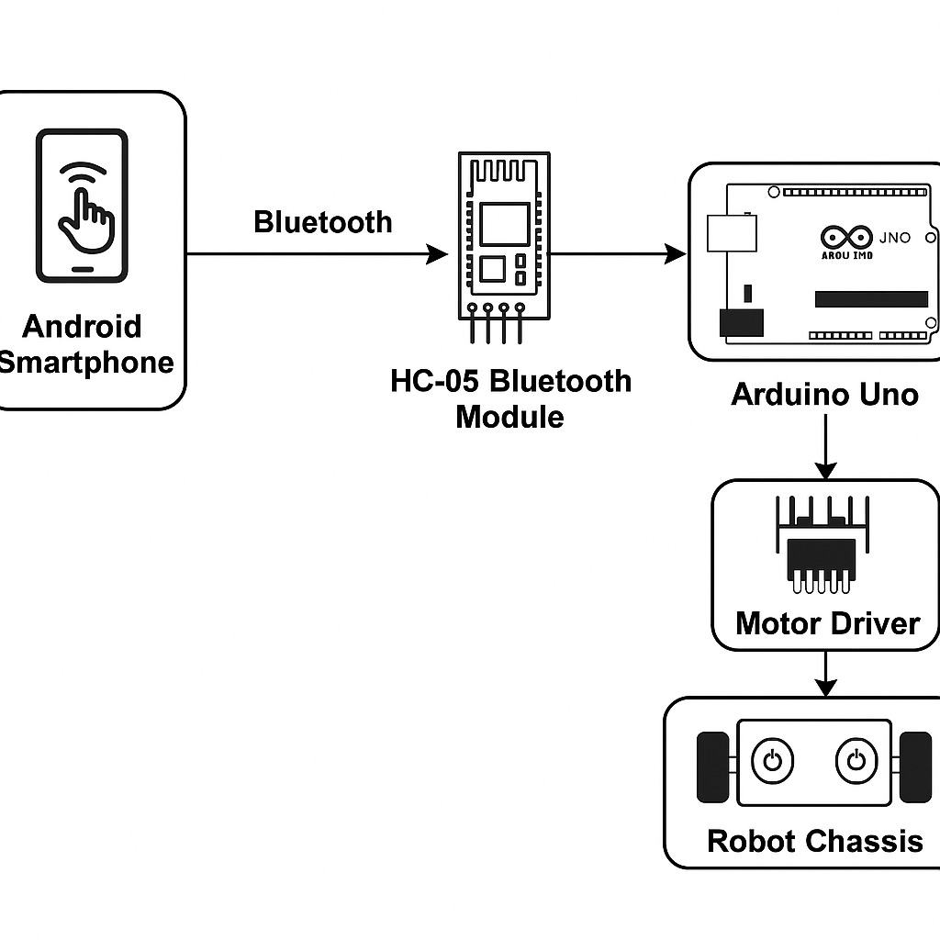
How Gesture Recognition Works
Gesture recognition involves capturing movement data through sensors like accelerometers and gyroscopes. The data is processed using algorithms that identify specific gestures and convert them into actionable commands. This technology allows for intuitive interaction without the need for physical controls.

Slide 4
Working Principle
The user tilts the smartphone, and the app detects the gesture using the gyroscope.
The app sends a command ('F', 'B', 'L', 'R', 'S') via Bluetooth.
The HC-05 Bluetooth module receives the command and sends it to the Arduino Uno via serial communication.
The Arduino processes the command and sets the motor driver (L298N) pins accordingly.
The L298N controls the DC motors, making the robot move in the desired direction.

Slide 5
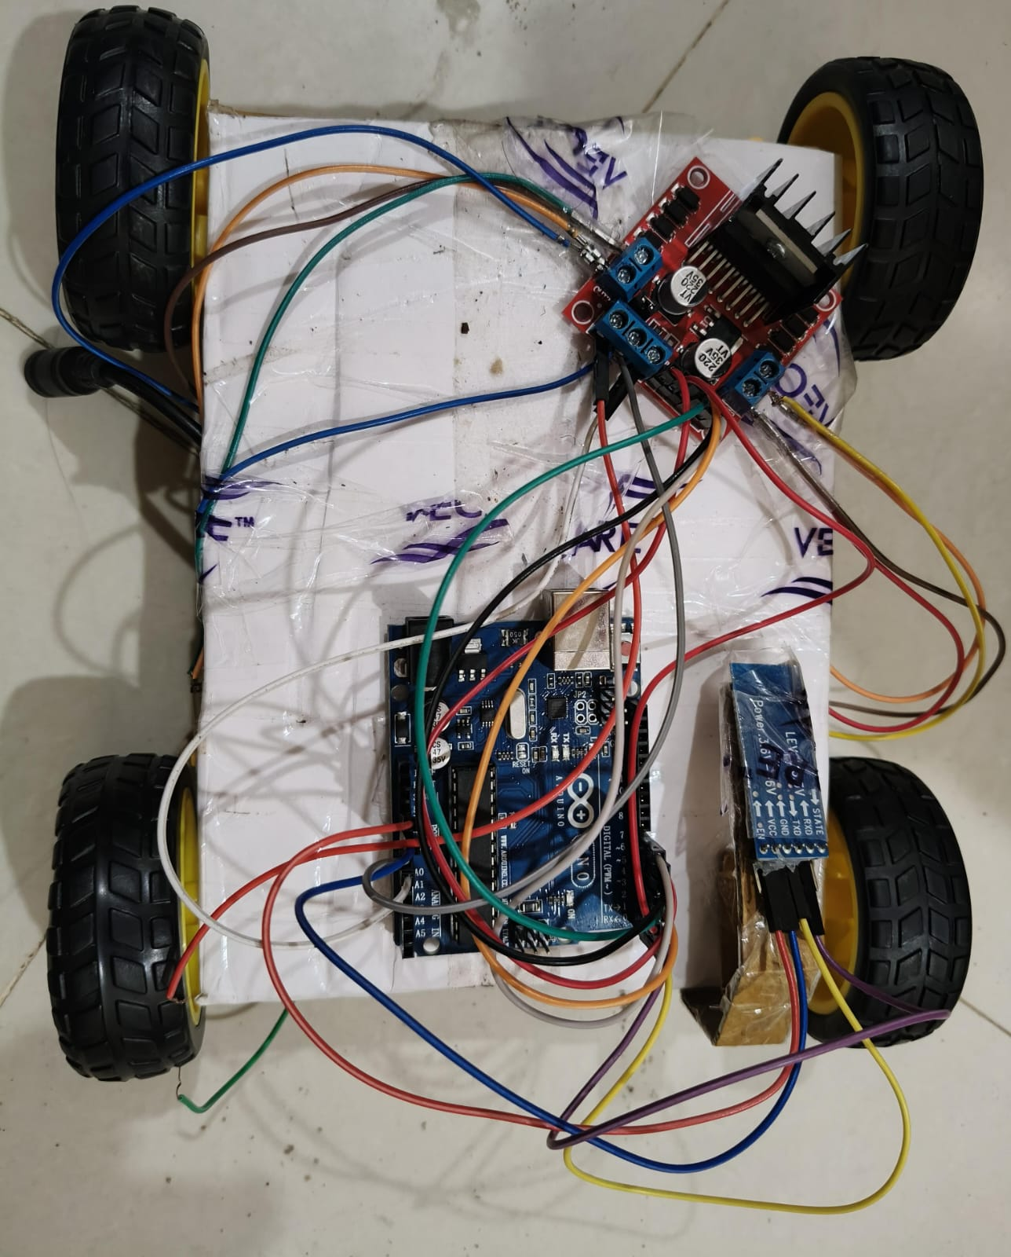
Circuit Diagram
The mobile app sends a gesture command (e.g., "F" for Forward) via Bluetooth.
HC-05 receives this command and sends it to the Arduino Uno.
Arduino interprets the command and sends HIGH/LOW signals to L298N IN1–IN4 to control the direction of motors.
Motors drive the car forward, backward, left, or right based on the signal.

Slide 6
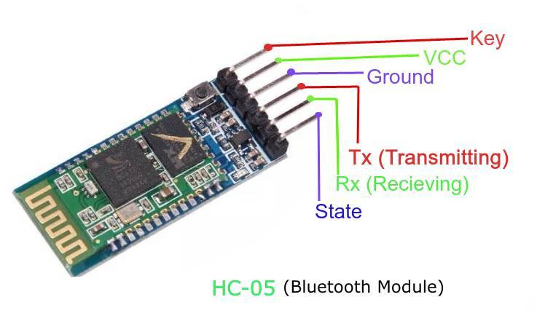
Bluetooth Technology Overview
Bluetooth is a short-range wireless communication technology used to connect devices. It enables seamless communication between the gesture control device (such as a smartphone) and the robot. The low energy consumption of Bluetooth makes it ideal for mobile applications, ensuring long-lasting functionality.

Slide 7
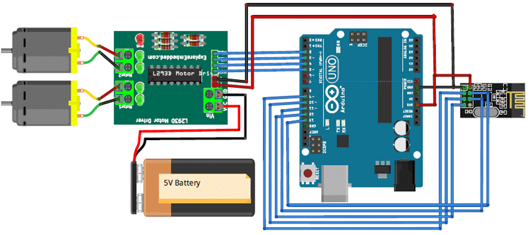
Components of Gesture Controlled Robots
Key components include the microcontroller, sensors, Bluetooth module, and motors for movement. The microcontroller processes input from the sensors and sends commands via Bluetooth to control the robot. Motors are responsible for executing the movements based on the received commands, allowing for precise maneuverability.

Slide 8
Advantages of Gesture Control
Gesture control offers a hands-free method of operation, improving accessibility for users. It enhances user engagement by providing a more interactive experience compared to traditional control methods. The ability to control robots from a distance increases safety, especially in hazardous environments.

Slide 9
Conclusion
Successfully built a gesture-controlled robot using simple and affordable components.
Demonstrates integration of hardware and software for real-world applications.
Future work: Add obstacle detection, camera module, or AI-based gesture recognition.

